Slide 1


Classification Models on Subreddit Posts: Blind and Deaf
CHONG SZE HUAN
Presented on: 17 March 2023

Slide 2

1. Problem Statement 2. EDA 3. Baseline Model and Metrics 4. Classification Models 5. Sentiment Analysis 6. Conclusion
Overview

Slide 3
Problem Statement
I am a researcher working for a community services center that aims to provide support to people with disabilities, including those who are deaf or blind.
In order to better understand the experiences and needs of these communities, subreddit posts related to deafness and blindness are classified and feedback and sentiment of these posts are evaluated.

Slide 4
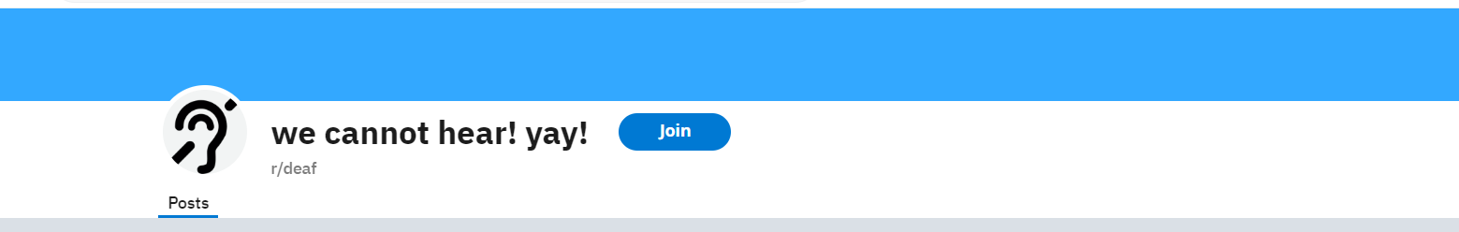

Subreddit

Slide 5
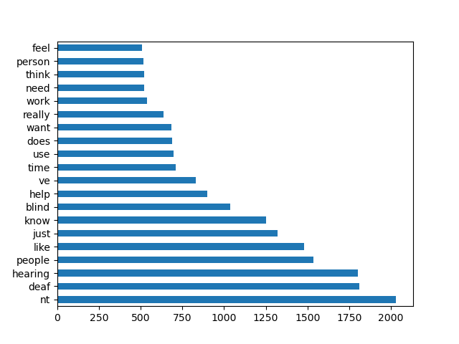
EDA
Keywords “blind” and “deaf” are removed in modeling.
Token 'nt' has no special meaning, they are just contraction like can't, don't, hasn't, haven’t.
Too many common words, so both Count and Tf-idf Vectors are included.

Slide 6
Baseline Model
Baseline model is simply the proportion of two groups in the model. Accuracy rate is 54%.
Generalization Error/ Variance
Sensitivity and Specificity
Accuracy
Metrics

Slide 7
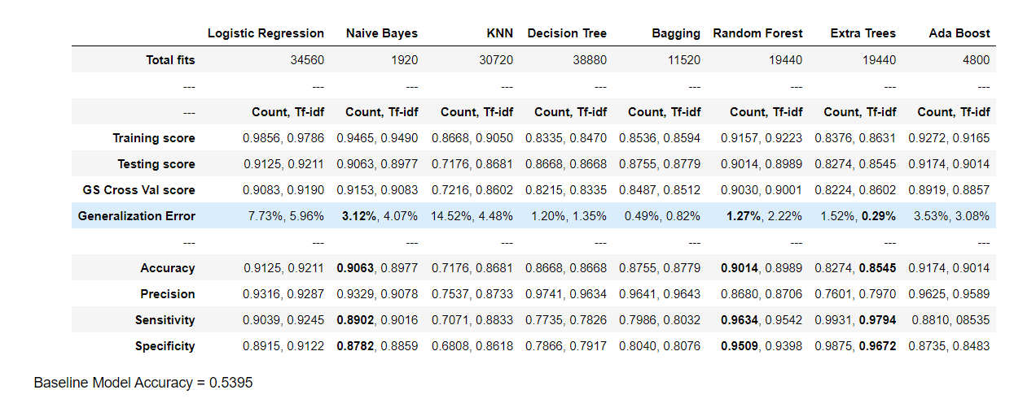
Classification Model

Slide 8
Classification Model

Slide 9
Sentiment Analysis
Blind community: 0.41 > Deaf community: 0.38
Sentiment score is in between of -1 to 1,
represent most negative to most positive.
Frustration and anger
Depression and loneliness
Discrimination and stigma
Some negative experiences are related to employment and education.

Slide 10
Sentiment Analysis
r/blind:
visually impaired
voiceover
low vision
visually
screen reader
rblind
guide dog
cane
jaws
braille
r/deaf:
asl
interpreter
hoh
hearing aid
audiologist
ci
hearing aids
signing
hearing loss
sign language

Slide 11
Conclusion

Slide 12
Thank you

